Slide 1
Social Exchange Theory: Why People Respond
Wenchao Ma
University of Minnesota

Slide 2
Social Exchange Theory (Homans, 1961; Blau, 1964; Dillman, 1978)
People are more likely to comply with a request from someone else if they believe and trust that the rewards for complying with that request will eventually exceed the costs of complying (Dillman, et al., 2014)

Slide 3
Social Exchange Theory
The exchange in survey research is information provided by the respondent to the researcher as the researcher provides the respondent with the opportunity
(1) to personally and visibly promote the social good,
(2) to be recognized and included,
(3) to express an opinion that will be valued and counted,
(4) to learn about a topic,
(5) to reflect on and come to decisions about aspects of a topic, and
(6) to satisfy his or her curiosity.

Slide 4
Social Exchange Theory - Rewards
Specify How the Survey Results Will Be Useful
Is it possible or likely that survey results will influence a community or organization decision?
Is public policy a likely beneficiary?
Ask for Help or Advice
This may help your respondents’ understand that they are uniquely able to answer the questions and feel like they are contributing to something. For many people, this is a reward.
Notes:
Many people feel a significant benefit when contributing to something that benefits others, even if they do not believe they will personally benefit directly. for example “Your feedback will help our reference librarians know how to provide better service to users like you.”
people often feel good when others ask them for advice or assistance that only they can provide.

Slide 5
Social Exchange Theory - Rewards
Ask Interesting Questions
When questions are interesting, and it can be explained in communications that the questionnaire will be interesting, people are more likely to feel they benefit from answering them.
Use Cash and Material Incentives to Encourage (but Not Require) Reciprocity
prepaid monetary incentives are the best
Notes:
However, what is interesting to one person may be of little interest to another.
One of the reasons that token cash incentives sent with a survey request have been shown consistently to be one of the most effective ways of improving survey response is that the surveyor has given something to the recipient, and he in turn sees it as appropriate to return the favor by completing the questionnaire, even though it is not required or mandatory.
monetary incentives sent in advance have larger effects than either gifts sent with the request or promised incentives and lotteries that are contingent upon completion of the survey.

Slide 6
Social Exchange Theory - Costs
Reduce the Burden of Length and Complexity
Only collect information that you know you will analyze
Have a data analysis plan in advance
Use Visual Design Principles to Make Questionnaires Easier to Complete
Make It Convenient to Respond
In mail surveys, this involves sending a business reply or stamped return envelope
In internet surveys, send email with link
Notes:
We often see surveyors trying to include as many questions as possible, often with each asking for extensive detail, into their surveys. Sometimes the additional questions and detail are included just in case, with no clear plan to use them. This is typically done because the surveyor does not know when or if he will get another opportunity to conduct a survey and wants to get as much information out of the current one as possible.

Slide 7
Social Exchange Theory - Costs
Avoid Subordinating Language
“For us to help solve the school problems in your community, it is necessary for you to complete this questionnaire.”
Will you please be a part of helping to solve the school problems in your community? Your responses can assist this community in fully understanding the issues facing schools here.
Notes:
The first statement subordinates the respondent to the surveyor using what might consider an adult-to-child style, whereas the second statement makes the respondent feel that the surveyor is dependent on him or her. Sensitivity to this issue may be especially important when surveying hard-to-reach populations and those who are disadvantaged or experience discrimination.

Slide 8
Social Exchange Theory - Costs
Recognize That Offering a Choice of Response Modes May Lower Response Rates
Minimize Requests to Obtain Personal or Sensitive Information
If sensitive information is needed, one should
ask the questions in a self-administered mode that provides more privacy for responding
ask them later in the survey to allow time for trust to develop
provide simple explanations for why responses to these questions are important and how the information will be protected
Notes:
offering people the choice of response modes simply does not improve response, and in some instances can even lower response rates. This is because offering a choice complicates the decision-making process, making it likely that some people will take no action at all.
Surveys often ask for information that some people do not want to reveal such as their income and other financial information, their health and medical history, and their past sexual behavior or drug use. Asking for sensitive information like this should be avoided whenever possible because it increases costs for respondents, but when obtaining sensitive information is absolutely necessary, there are several things that can be done to reduce the costs to respondents of providing it.

Slide 9
Social Exchange Theory - Trust
Emphasize Sponsorship by a Legitimate Authority
Government agency
University
Assure Confidentiality and Protection of Data
Explain the efforts that will be taken to ensure the confidentiality and security of people’s survey responses
Be careful not to overdo it
Notes:
People are more likely to comply with a request if it comes from an authoritative source. it is not surprising that for some time, government-sponsored surveys have achieved higher response rates than those sponsored by marketing research firms. Universities are also authoritative sources. However, there is some evidence that the effect of university sponsorship may be more localized than that of government sponsorship. Some researchers found that university sponsorship increased response rates in areas near the university, but decreased response rates in areas near a competing university.
one way surveyors can establish trust is by explaining the efforts that will be taken to ensure the confidentiality and security of people’s survey responses. going to great lengths and detail to explain how confidentiality will be assured when the survey is not terribly sensitive is more likely to raise concerns about the data being collected than to resolve such concerns. strong confidentiality assurances can be beneficial, increasing response, when the survey topic is sensitive. Much like the use of incentives, when assuring confidentiality and data protection, there is a need to achieve optimal levels, but not make respondents suspicious by offering excessive amounts of money or overexplanations of confidentiality and protection.

Slide 10
Social Exchange Theory - Trust
Provide Ways for Sample Members to Assess the Authenticity of a Survey Request and Ask Questions About It
providing a physical address where the sponsor is located
listing a toll-free number that sample members can call to talk to a real person
include a web address where sample members can find additional information about the sponsor, background on the survey, and even results from previous surveys
a specific e-mail address for asking questions should be made available

Slide 11
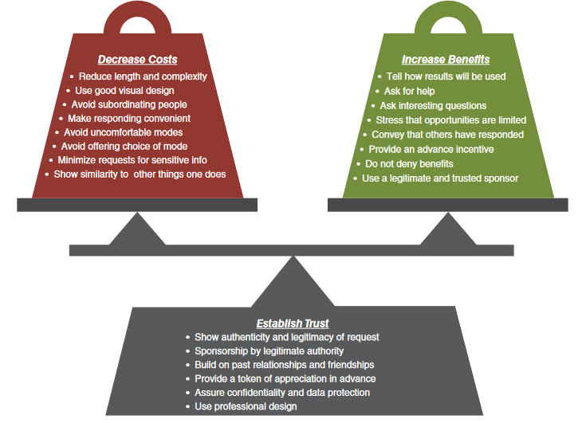

Slide 12
Example: WSU Doctoral Student Experience Survey
The study was targeted toward students who had successfully completed their required preliminary examinations and had only to finish the dissertation in order to meet their degree requirements.
Data collection needed to be completed within about a month.

Slide 13
Example: WSU Doctoral Student Experience Survey
Target Population
WSU Graduate Students working on their dissertations
Topic
Experience with Doctoral Program and Dissertation Process.
Sample Frame
Contact Information: Names, addresses, and emails provided by the university registrar
Timeline
One Month
Budget
Interviewers were unaffordable

Slide 14
Example: WSU Doctoral Student Experience Survey
Day 1: Send a postal letter asking students to respond over the web. Enclose a $2 incentive with this request.
Day 4: Send an e-mail that builds upon the information contained in the invitation letter, while emphasizing that the sender is following up by e-mail to provide an electronic link to the survey with the hope that this will make responding easier.
Day 10: Send a second e-mail request.
Day 18: Send a postal letter offering the option of responding via mail. Include a paper questionnaire and an addressed and stamped return envelope.
Day 22: Send a final e-mail follow-up.

Slide 15
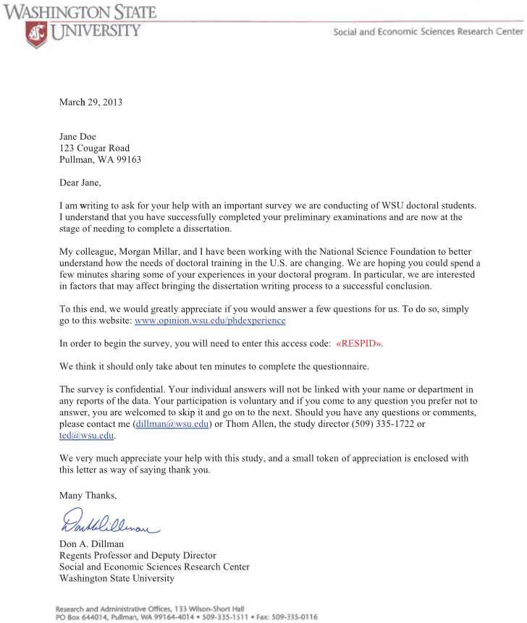
Initial communications
Initial communications sent to students asked to complete the WSU Doctoral Student Experience Survey (inside addresses have been altered)
Notes:
The survey was sponsored by a research center at Washington State University, providing a certain amount of legitimacy (increase benefits and trust), especially since the population of interest was students completing a doctorate degree at that university. The invitation letter asking recipients to respond over the Internet was printed on official university stationery and also provided names and contact information for the study director and office from which the study was being implemented, providing further legitimacy (increase trust). An additional aim was to create trust that something useful to future graduate students would result from the study (a potential benefit because of the identity some students were developing with their department). The inclusion of the $2 bill with the request and referring to it as a “token of appreciation” was aimed at communicating the importance of each response (a benefit) and providing a direct and unconditional benefit to the recipient (increase trust), although this was less of a concern in this survey situation than it might have been in others because the survey originated from within the university.

Slide 16
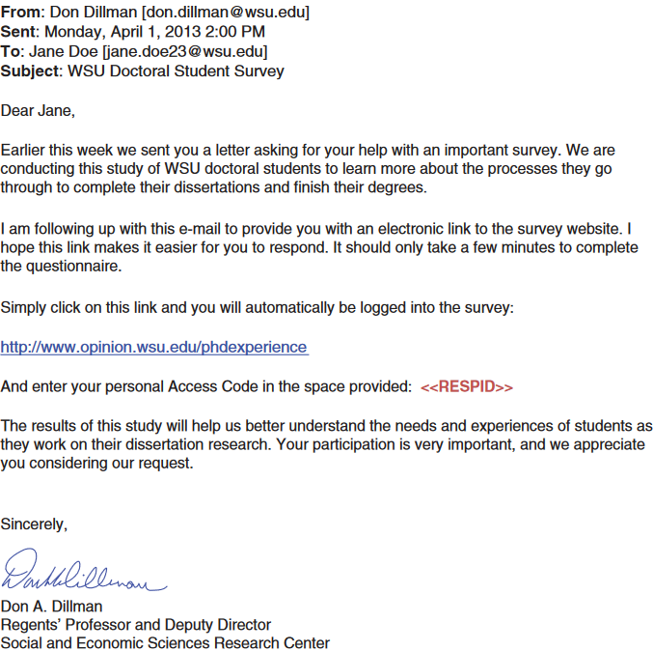
Second contact: E-mail
Notes:
The immediate e-mail follow-up, that can be thought of as e-mail augmentation of the paper contact in order to provide an electronic link was designed to reduce the effort needed for sample members to transfer the URL and password from the paper letter to the computer (reduce costs). The wording in this e-mail emphasized this attempt to reduce the cost of time and effort by providing an electronic survey link and explaining that it was included to make it easier to respond, as illustrated in Figure 2.4. The additional follow-ups each conveyed new information and discussed the usefulness of the study with different words to spread the appeal (cf. Millar, 2013).

Slide 17
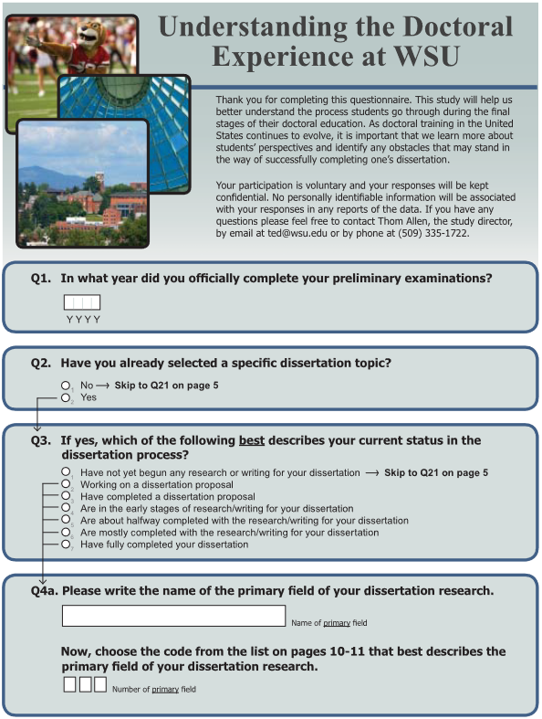
The initial page of the paper questionnaire
localized identity
Short questionnaire
Notes:
an appealing but vague title, “Understanding the Doctoral Experience at WSU,” which gave the questionnaire a localized identity (increase benefits)
the questionnaire was kept reasonably short (reduce costs) and limited to 44 questions

Slide 18
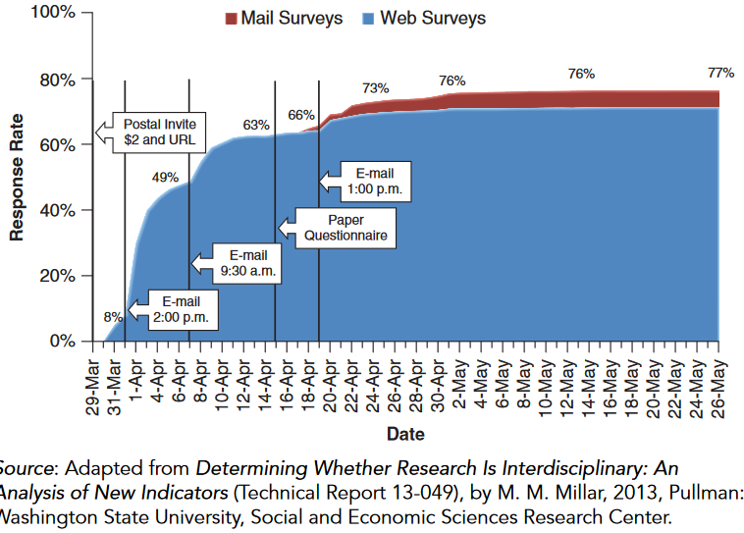
Example: WSU Doctoral Student Experience Survey

Slide 19
